Slide 1
September 22, 2023
Pennsylvania Health Care Cost Containment Council
225 Market Street
Suite 400
Harrisburg, PA 17101
phc4.org

Slide 3
About PHC4
PHC4 is an independent state agency formed under Pennsylvania statute (Act 89 of 1986, as amended by Act 15 of 2020).
PHC4 produces comparative information about the most efficient and effective health care, working to improve the quality of health care and restrain costs.
We support this by providing research, analysis, and reporting on quality, outcomes, and hospital finance across Pennsylvania.

Slide 4
About PHC4
At PHC4 we collect, analyze, and report data specific to Health Care in Pennsylvania that is nonpartisan, and fact based.
Our reports are based on data received from all Hospitals and Ambulatory Surgery Centers in Pennsylvania.
PHC4 also supports those focused-on issues in medical education, population health, and clinical research through data sales.
PHC4 data sales assist stakeholders in efforts such as:
Internal benchmarking
Process improvement
Specialized clinical research

Slide 5
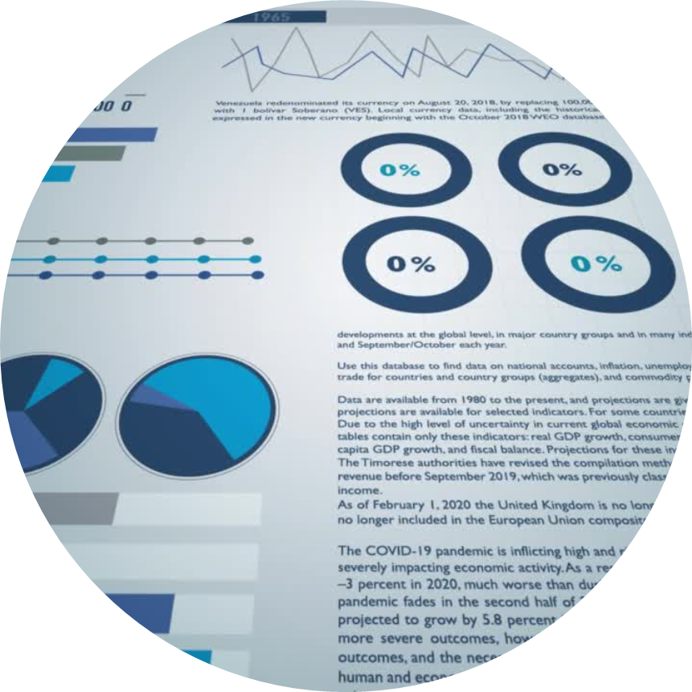
Defining PHC4’s Process
An overview of PHC4’s process of data collection
Facilities required to submit data to PHC4
Type of data submitted
Data is submitted quarterly

Slide 6
Data Submission Schedule

Slide 7
Defining PHC4’s Process
Data Elements (UB-04 claim form)
Patient Data – DOB, sex, SSN, name, address
Claim Data – MRN, from/through dates, revenue codes
Hospitalization Information – discharge status, source of admission (e.g., transfer)
Payer Information – Insured’s unique ID, payer type (Medicare, Medicaid, commercial, Blue Cross, Government) and line of service (PPO, POS, FFS, HMO)
Diagnoses and Procedures
Charge Information

Slide 8
Severe Maternal Morbidity Research Brief
Methods
Identification of SMM cases (AIM)
Facilities included in the data
All PA counties included in the data
Analysis includes delivery hospitalizations; out-of-hospital deliveries are not included
PA residents vs Non-PA residents

Slide 9
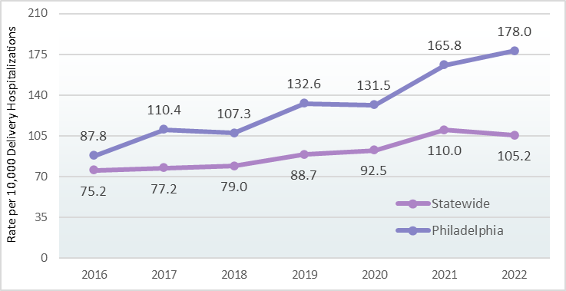
Severe Maternal Morbidity - Philadelphia

Slide 10
Severe Maternal Morbidity Research Brief
PHC4 offers a more in-depth discussion of the data shared in this recent report.
Insight into severe maternal morbidities by race and ethnicity.
A discussion regarding transfusions.
Discussion about SMMs that might be preventable.
Study focused on maternal outcomes; what about the baby’s outcome?

Slide 11
Severe Maternal Morbidities
by Race/Ethnicity
SMM Type | Total Number of Cases | % Black, non-Hispanic | % Hispanic | % White, non-Hispanic
Acute Renal Failure | 857 | 27.9% | 11.9% | 49.7%
Disseminated Intravascular Coagulation | 594 | 21.0% | 9.8% | 56.1%
Adult Respiratory Distress Syndrome | 360 | 20.0% | 11.9% | 56.4%
Hysterectomy | 329 | 16.4% | 12.8% | 60.5%
Shock | 247 | 20.6% | 9.7% | 57.1%
Sepsis | 244 | 21.7% | 15.2% | 45.9%
Pulmonary Edema/ Acute Heart Failure | 196 | 26.0% | 6.6% | 54.6%
Eclampsia | 165 | 29.7% | 7.9% | 48.5%
Puerperal Cerebrovascular Disorders | 149 | 30.2% | 8.1% | 55.0%
Ventilation | 104 | 27.9% | 10.6% | 53.8%
Air and Thrombotic Embolism | 101 | 23.8% | 8.9% | 58.4%
Sickle Cell Disease With Crisis | 43 | 90.7% | 7.0% | 2.3%
Cardiac Arrest/ Ventricular Fibrillation | 25 | 12.0% | 4.0% | 84.0%
Other | 88 | 17.0% | 13.6% | 62.5%

Slide 12
Severe Maternal Morbidities
Rate per 10,000 Delivery Hospitalizations
SMM Type | Black, non-Hispanic | Hispanic | White, non-Hispanic | Age 12-39 | Age 40-55
Acute Renal Failure | 67.4 | 42.2 | 26.9 | 33.8 | 73.3
Disseminated Intravascular Coagulation | 35.2 | 24.0 | 21.0 | 23.6 | 45.7
Adult Respiratory Distress Syndrome | 20.3 | 17.8 | 12.8 | 14.3 | 26.4
Hysterectomy | 15.2 | 17.4 | 12.6 | 12.5 | 40.9
Shock | 14.4 | 9.9 | 8.9 | 9.7 | 21.6
Sepsis | 14.9 | 15.3 | 7.1 | 9.7 | 18.0
Pulmonary Edema/ Acute Heart Failure | 14.4 | 5.4 | 6.8 | 7.6 | 19.2
Eclampsia | 13.8 | 5.4 | 5.1 | 6.7 | NR
Puerperal Cerebrovascular Disorders | 12.7 | 5.0 | 5.2 | 5.9 | 13.2
Ventilation | 8.2 | 4.6 | 3.5 | 4.2 | NR
Air and Thrombotic Embolism | 6.8 | NR | 3.7 | 3.9 | NR
Sickle Cell Disease With Crisis | 11.0 | NR | NR | 1.8 | NR
Cardiac Arrest/ Ventricular Fibrillation | NR | NR | 1.3 | 0.9 | NR
Other | 4.2 | 5.0 | 3.5 | 3.5 | NR

Slide 13
Transfusions
What if transfusions were included?
Challenges associated with studying transfusions.

Slide 14
Are SMMs preventable?

Slide 15
Do we link maternal delivery hospitalizations to the baby?

Slide 16
Discussing the Impact of Coding
How has the transition from ICD-9-CM to ICD-10-CM impacted hospital coding?
Are there concerns about under coding, and could rates of depression, anxiety, obesity, etc. be calculated?

Slide 17
Discussing the Depth of Coding
Type of Hospitalization | Number of Cases | Average Number of Diagnoses
Deliveries with SMM | 2,625 | 14.8
Deliveries without SMM | 241,286 | 8.9
Total Deliveries | 243,911 | 9.0

Slide 18
Accessing PHC4 Reports & Data
Browse our library anytime at https://www.phc4.org/browse-our-data/
Online
Need help finding something, contact us through our website at https://www.phc4.org/about-the-council/contact-us/
Email
Purchase Data
PHC4 offers one time and continuous data purchases, to find out more email us at https://www.phc4.org/request-custom-data/

Slide 19
Jane Keck, PhD, MS
jkeck@phc4.org
Barry D. Buckingham
bbuckingham@phc4.org
Katie Jordan
kjordan@phc4.org
Thank You
225 Market Street
Suite 400
Harrisburg, PA 17101
phc4.org

